Slide 1

External Sharing and User deprovision with Identity Governance and Automation
Dan Jorenby Area Solution Architect (MSC)
Notes:
Do not show
Tell story of customer
New to O365
Replacement of FTP and Citrix ShareFile
Provisioning and deprovisioning of users in FTP and Citrix ShareFile

Slide 2
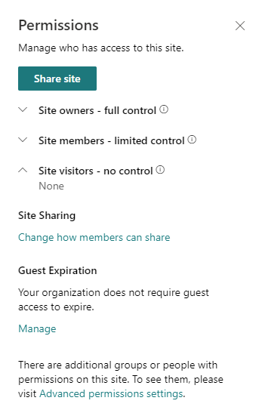
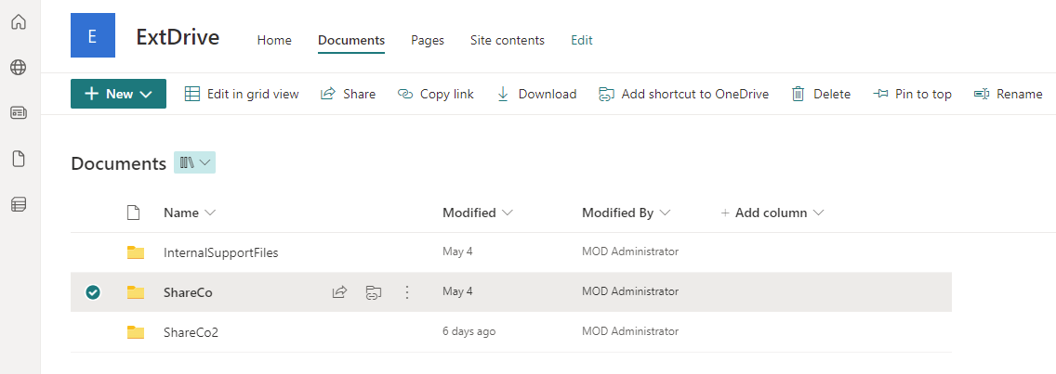
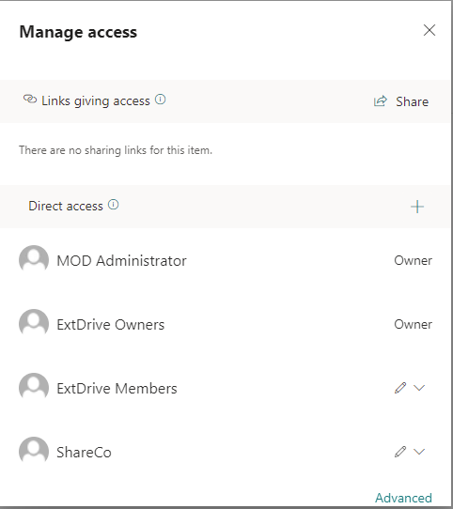
SharePoint Site External Sharing Layout
Visitors removed
Notes:
Slide 1 display

Slide 3
SharePoint Share and Folder Permissions so far..
For admins steps
Create SharePoint Site for each department external share
Create sub folders for each business partner of the department
Create AAD group for each business partner folder
Add the AAD group to each folder and remove visitor access
Add users / B2B accounts to AAD security groups
Notes:
Show
As you can see, the architect (me) is not wining any prizes for ease of the solution
The customer loves the solution, but it must be simpler
Tell story of CISO user deprovision problem

Slide 4
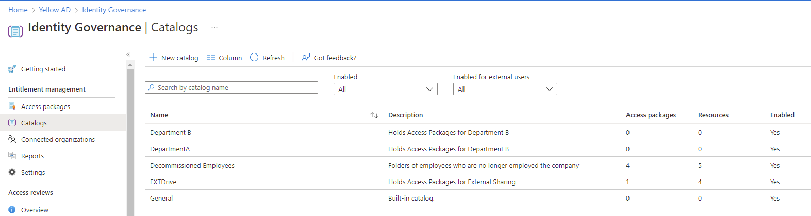
Access Package Catalog Structure
Notes:
Show
Catalog Delegate Access Packages
Department A delegated to Department A admins
Department B delegated to Department B admins
EXT Drive delegated to IT Admins
Decommisioned Employees for users that have departed company

Slide 5
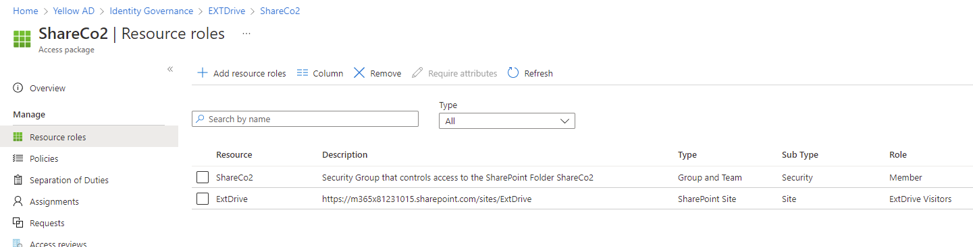
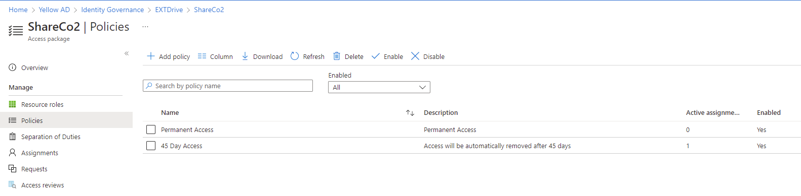
Access Package Structure
Notes:
Show
2 Resources
SharePoint Site Visitor Access
User is added as member of the AAD security group
Policy governs how long user has access, required approvals, renewal policy
ShareCo2 - Microsoft Azure

Slide 6
More tasks for IT Admins
IT Admin one time step
Create SharePoint Site for each department external share
Create sub folders for each business partner of the department
Create AAD group for each business partner folder
Add AAD group to each folder and remove visitor access
Add users / B2B accounts to AAD security groups
Create Access Package
Add SharePoint Site with visitor access
Add Security group with member
Create Access Package Policy
Operational
Create B2B invite
Add B2B user to Access Package
Notes:
Show slide when script is running | spit screen with PS scripts running
1) - AD Hoc Access Package Creator.ps1 – Create Access Package and SharePoint components
2) - Access Package Inviter - lab.ps1 – Simplifies inviting and granting access to Business partners
Dialog about user deprovisioning
Next conversation is about user deprovisioning

Slide 7
Expanding on the solution | User deprovisioning
Customer need a solution to preserve users OneDrive that had left the agency while allowing the manager of the user 60 day access to the users OneDrive
We leverage the same SharePoint security pattern except this is all internal
Notes:
Do not show

Slide 8
Notes:
Talk to flow
Talk to why logic
Talk to why used Run As
Futures the Run As to a Managed Identity
How do I get started with Automation Account
Dan to do final code clean

Slide 9

Thank you

Slide 10
But first ,a chat with the CISO
The CISO was pleased with the sharing security pattern but was very concerned about deprovisioning. While a B2B account loses access when the home account is deleted, there was no faith that would happen and how do we handle role changes, i.e. the home account user does not need access anymore.
Azure Access Packages to the rescue
1 Access Package for each business partner folder within a department external sharing site
Resources
SharePoint Site (visitor access)
AAD Security Group that secures the business partner folder
Access Policy controls time of access and attestation (do you still need access)
Notes:
Do not show dialog
FTP user deprovisioning

Slide 11
Customer background
Customer is a state agency that interacts with numerous healthcare providers through a state
They need to be able to securely receive and share files with healthcare providers as well as provision and deprovision access to shares.
The ability to grant and remove access to “shares” should be delegated to department administrators, while ensuring that the IT departments security policies are strictly adhered to.
Customer is replacing
Home grown FTP Site
Citrix Share File
Deprovisioning in both legacy systems was effectively not done, meaning there were many accounts that had access to “shares” and should not have.
Customer owned Azure AD licenses P2, and wanted to maximize ROI
Notes:
Team to chat this content, No show
Add in Admin user personas
Department Admin Green
Global Admin Red
Catalogs
Create Visio of solution
This is verbal move slide content to notes

Slide 12
DEMO 1
Notes:
Describe key aspects of script
Order of operations waiting for Cloud objects
Show Emails

Slide 13
User decommissioning
Requirements:
Manager should have access to OneDrive for 60 days
Access Packages with previously described SharePoint security pattern
User license should be released immediately
Convert mailbox to Shared
Users email should be released
Rename user accounts on premise (On premise remote mailbox)
After 60 Days the account should be deleted yet the OneDrive content should be available via eDiscovery
https://m365x81231015.sharepoint.com/sites/UserArchive
Each decommission user has a folder within the SPO user archive site secured
The manager is granted access to the Site/Folder via Access Package(s) created by Azure Automation Account runbook
Notes:
Setup
Have user created
Populate stuff in OneDrive

Slide 14
User decommissioning solution
On premises PowerShell
Runs set-remotemailbox commands
Azure Automation Account | PowerShell RunBooks
Run PowerShell commands against AAD
Modules used
ExchangeOnlineManagement
PnP.PowerShell minimum version 1.7.0
MicrosoftTeams
az.automation
az.accounts
MSAL.PS
Microsoft.Graph.Identity.Governance
Microsoft.Graph.Authentication
Tip: Runbooks can execute on premise PowerShell commands via HybridWorker
Key Vault – Holds certs and secrets
Logic Apps
Copies OneDrive content to folder in UserArchive site
Notes:
Describe the SharePoint site structure

Slide 15
User decommissioning process
Run on premise Decommission script.
All the rest is automated
On premise custom attributes
CA1 – Decommission Date
CA2 – Manager of the decommissioned user
EXO-# - indicates the Exchange online processing stage
OD-# - indicates the OneDrive processing stage
CA4 – Processing Stage (EXO-#,OD-#)
EXO-0 not started
Runbook grants the manager full access to the mailbox
EXO-1 (setting manager completed)
OD-0 not started
Runbook creates Access Package, AAD security groups, grants permission, assigns manager to access package
OD-2 Runbook operations complete
Notes:
1 Run decommissioning script
2 Run AAD sync cycle
3 Show custom attributes

Slide 16
User decommissioning continued
OD-# - indicates the OneDrive processing stage
CA4 – Processing Stage (EXO-#,OD-#)
OD-0 not started
Runbook Creates AAD security group name dc.<samaccountname>.#
Runbook adds the manager to security group based CA2 value
Runbook add security group to User Archive Access Package Catalog
Runbook adds SharePoint site to User Archive Access Package Catalog (only needs be done once)
Runbook creates Access Package
UserArchive SPO Site
Security group
60 Day policy
Runbook assigns manager defined in CA2 to the Access Package
Runbook creates SPO Folder in userarchive site named dc.<samaccountname>.#
Runbook removes visitor group from the folder and grants dc.<samaccountname>.# security group Read access to the folder
Runbook Sends JSON to Logic Apps to copy data from OD to SPO
Runbook sets CA4 “DC-OD-2” (indicates the OD processing complete)
Notes:
1 Run decommissioning script
2 Run AAD sync cycle
3 Show custom attributes

Slide 17
Solution PowerShell script
To simplify I automated all the of the steps via PowerShell
The solution was created mid 2021 needed to use Graph APIs via PowerShell
PS Modules used
Install-Module AzureAD
Install-Module MicrosoftTeams
Install-Module Az.Accounts
Install-Module -Name MSAL.PS
Install-Module -Name PnP.PowerShell
And now for a DEMO

Slide 18
User decommissioning logic App Stage
Notes:
1 Run decommissioning script
2 Run AAD sync cycle
3 Show custom attributes
4 Run M365 RunBook

Slide 19
SharePoint Site Layout (deprecated)
The solution was leverage SharePoint and Azure AD Guest Account (B2B) accounts.
Since there was numerous departments within the Agency that needed external sharing capabilities, each department got their own SharePoint Site.
Today's demo 1 layout
https://m365x81231015.sharepoint.com/sites/DepartmentAExternalSharing
https://m365x81231015.sharepoint.com/sites/DepartmentBExternalSharing
For smaller departments there was a catch all SharePoint site for external sharing. (This is the site we will explore today)
https://m365x81231015.sharepoint.com/sites/ExtDrive
Notes:
To do 5/6Change to diagram (Visio)
Remove all text

Slide 20
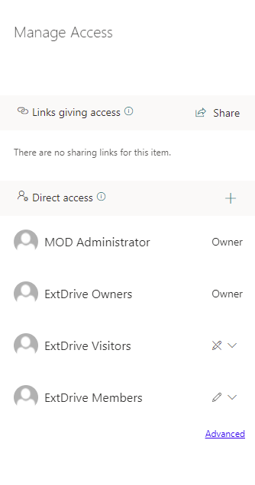
SharePoint Site Layout (deprecated)
Each Site was configured with the same default permissions structure.
https://m365x81231015.sharepoint.com/sites/ExtDrive
Top Level Permissions were left as default
Site delegation was done via Owners group
Department A are site owners of DepartmentA site
Department B are site owners of DepartmentB site
EXTDrive had IT Admins as site owners, shares were created on request
Notes:
Visio
Remove all text

Slide 21
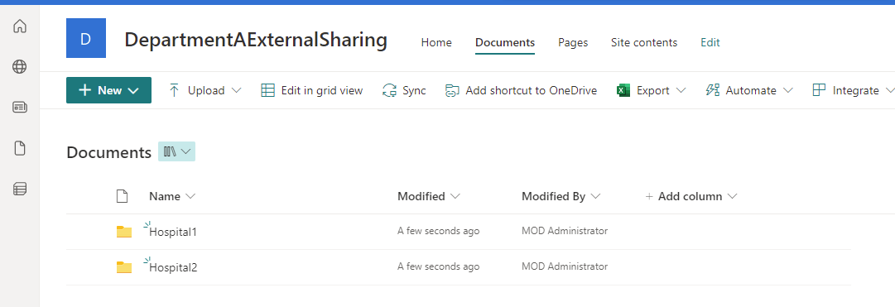
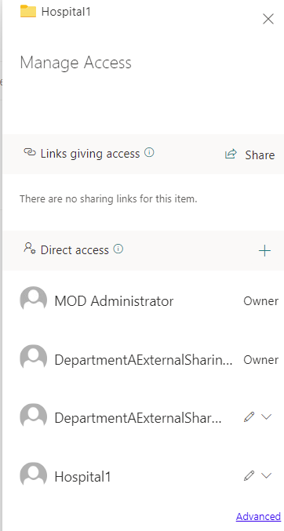
SharePoint Folder Permissions with a site (deprecated)
Within each site, each department has different business partners
Business partners (hospitals) should not be able to access each others folder nor even see the folder
To achieve this
Create AAD Security groups for each business partner
Add the AAD security group to each folder
Remove visitor group from the folder
The AAD Group Hosptial1 has edit SPO permissions one the folder
Notes:
Describe the SharePoint site structure
Make graphics bigger slide show

Slide 22
The journey of a lifetime: Governing your employees and external users and their apps
Speaker name
Notes:
[Talk Track]
Today more than ever, organizations need to protect who has access to their applications and data. It is important to have a comprehensive identity governance solution, to ensure the right access for the right users at the right time. In this session we will take a look on how Identity Governance can help your organization to achieve its goals.

Slide 23




Meet Contoso
Jeevan
Megan
Nestor
Franklin
Business Manager
IT Operations Manager
Compliance Officer
InfoSec Director
I need my employees to have speedy and efficient access to the resources required to do their work.
I want authorized business users to manage and request access.
I want to reduce operational costs.
I want to automate processes like password management, provisioning, access requests and access certifications.
I need to validate that the right controls are in place to meet mandatory security and privacy requirements.
I want to setup repeatable procedures for a more auditable and simpler way to manage access certification attempts.
I would like to reduce risk and strengthen security.
I want to have centralized visibility and establish an authoritative source of who has access to what and to what extent.
Notes:
[Talk Track]
Meet Contoso. Even though Contoso is our fictional company, just as other organizations they need to protect who has access to their applications and data. However, throughout the company departments have different needs.
Jeevan, Contoso's business manager, wants that employees have timely and effective access to the resources required to do their work. Where Megan, Contoso's IT Operations Manager, is looking to reduce operational costs by automating processes like password management, provisioning, and access requests.
For Nestor, Contoso's compliance officer, compliance and audit performance is important. He wants to validate that the right controls are in place to meet mandatory security and privacy requirements and setup repeatable procedures for a more auditable and simpler way to manage access certification. Lastly, Contoso's InfoSec Directory Franklin is looking to reduce risk and strengthen security. He wants centralized visibility and establish an authoritative source of who has access to what and to what extent.

Slide 24


Contoso’s Hero team Their assignment: Identify a comprehensive identity governance solution, to ensure the right access for the right users at the right time.
Lynne
Cloud Security Architect
Lynne reports to Franklin but is also part of Nestor's compliance v-team. She will make sure that Nestor's and Franklin's requirements are met.
Joe
Identity Architect
Joe reports to Megan and will focus on her requirements around automation. Their main customers are the business, so Jeevan's requirements are equally important for him.
Notes:
[Talk Track]
Contoso formed a virtual team consisting of Lynne, a cloud security architect that reports to Franklin (director of InfoSec) but she is also part of Nestor’s compliance v-team, and Joe, an identity architect that reports to Megan and works a lot with Jeevan. They have the assignment to look for a comprehensive identity governance solution and to make sure that the requirements of the four key stakeholders are taking care of.

Slide 25



What is Azure AD Identity Governance?
Onboarding / Provisioning
01
02
Who has/should have access to which resources?
What are they doing with that access?
Access Lifecycle Management
Access Recertification
Identity
03
04
Are there effective organizational controls for managing access?
Can auditors verify that the controls are working?
Secure privileged access for administration
Notes:
[Talk Track]
Lynne and Joe decided to investigate the capabilities of Azure Active Directory (Azure AD) Identity Governance. Azure AD Identity Governance allows you to balance your organization's need for security and employee productivity with the right processes and visibility. It provides you with capabilities to ensure that the right people have the right access to the right resources at the right time.
Identity Governance give organizations the ability to do the following tasks across employees, business partners and vendors, and across services and applications both on-premises and in clouds:
Govern the identity lifecycle
Govern access lifecycle
Secure privileged access for administration
Specifically, it is intended to help organizations address these four key questions:
Which users should have access to which resources?
What are those users doing with that access?
Are there effective organizational controls for managing access?
Can auditors verify that the controls are working?

Slide 26










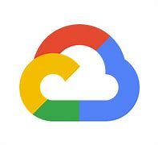

Microsoft’s Identity Management and Governance strategy
Identity governance is an extension of identity and access management, delivered in Azure AD
Cloud governed management
Manage from the cloud and fully support on-prem via cloud connectors
Self-service to support business level decisions
Policy driven automation – reviews, requests, approvals
Analytics driven insights and alerting to address compliance reporting needs
Extensibility through standards, APIs and partnerships
SaaS apps
Partners
Cloud infrastructure
Azure Active Directory
On-premises applications
Active Directory
Notes:
[Talk Track]
Contoso invested a lot into the migration to the cloud. One of their requirements when looking at new solutions is "Is it a cloud solution?". This fits nicely with Microsoft's strategy on Identity Management and Governance. Microsoft's Identity Governance capabilities are an extension of the identity and access management capabilities that are delivered by Azure AD. Even though it is cloud governed management, there is the possibility to reach back to on-premises when necessary. It focuses on self-service to support business level decisions, policy drive automation and analytics driven insights and reporting to address compliance reporting needs. Just as the rest of Azure Ad it is built using industry standards and it provides API's so that partners (or customers) can easily integrate with the solution.

Slide 27









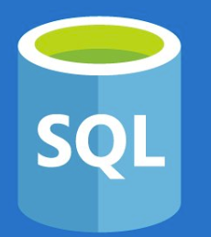
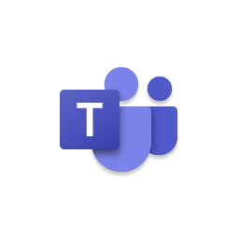
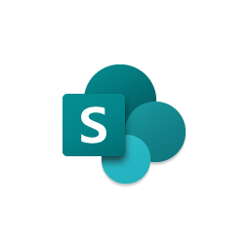
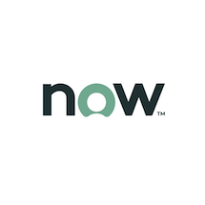
Contoso’s user journey
Just-in-time access, alerts, and approval workflows to protect access to critical resources
Automate the granting of access rights to resources
SaaS apps
Onboard the user into the directory when the user joins or start working with Contoso
On-premises apps
Access recertification to reduce risk
Self-Service access request when additional access is needed
Make sure access rights are removed when user leaves or stops working with Contoso
Teams sites
SharePoint Libraries
Ongoing auditing & reporting
Notes:
[Talk Track]
To start their investigation, Lynne and Joe have taken the journey of a user at Contoso. From the moment that he/she is hired till the moment that he/she is leaving the company, to see how Azure AD Identity Governance can help them. When a user, and that can be an employee as well as an external user, joins Contoso there are several phases in the identity lifecycle.
Upon joining Contoso, the user needs to be onboarded into Contoso’s directory. The next step would be to automatically grant the right access for this user and users may need additional access rights. Contoso wants to provide users with the ability to do self-service access requests for those additional access rights. To reduce the risk of stale or unneeded access, Contoso wants to do periodic access recertification and if the user happens to be an admin it wants to use the principle of least privileged access. And off course if the user leaves Contoso access rights need to be removed. During the whole lifecycle there needs to be ongoing auditing and reporting.

Slide 28


Contoso’s user journey
Just-in-time access, alerts, and approval workflows to protect access to critical resources
Automate the granting of access rights to resources
SaaS apps
Onboard the user into the directory when the user joins or start working with Contoso
On-premises apps
Access recertification to reduce risk
Self-Service access request when additional access is needed
Make sure access rights are removed when user leaves or stops working with Contoso
Teams sites
SharePoint Libraries
Ongoing auditing & reporting
Notes:
[Talk Track]
Now let's take a closer look at the different steps in this user journey and start with onboarding a user into the directory,.

Slide 29




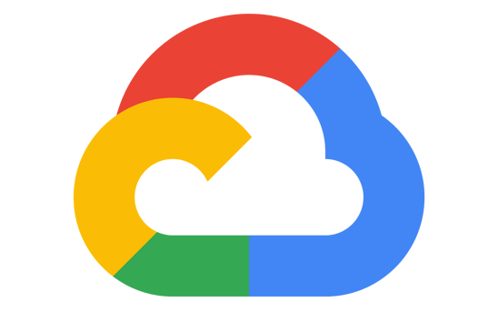






Onboard any user Inbound provisioning
SaaS apps
Cloud-hosted apps
Amazon Web Services
Microsoft Azure
Google Cloud
Single sign-on and provisioning
HR systems
Azure AD
Azure AD App Proxy and
Provisioning agents
App delivery controllers & networks
External identities
Active Directory
On-premises applications
Notes:
[Talk Track]
The first step in Contoso’s user journey is to onboard the user into the directory. A user can come into the directory in different ways:
Via a connected HR system,
as an external identity (also known as a guest user),
synchronized from your on-premises directory via Azure AD Connect,
created manually or bulk uploaded through a CSV file.
Especially the integration with HR systems is interesting for Contoso because this achieves a high degree of automation (A requirement from Megan, the IT Operations manager) and they will have a single source of truth for accounts.

Slide 30



Enable HR-driven user provisioning
Key Features
Customer Benefits
Direct API-based integration with Cloud HCM as authoritative identity source
Onboarding & offboarding workflows automation
Automated creation of user accounts in Azure AD and on-premises AD for new employees and contractors
Decommission HR flat-file based integrations
Automated identity lifecycle between IT and HR user profiles, including writeback from Azure AD to HCM
Enhanced security, improved compliance and better productivity
Configurable termination events to automatically disable user account and access to applications
New Hire
User
Termination
Cloud HCM
Microsoft Azure Active Directory (synced with AD)
Joiner-Mover-Leaver Process
User
Resignation
(Effective dated)
User Location / Department Change
User Promotion

Slide 31



Enable collaboration with external partners
Other organizations
Azure AD
Add partners with accounts
in other Azure AD organizations
Add users with non-traditional IDs, including email one-time passcode
Add users with social IDs, or other Identity Provider accounts

Slide 32

Manage your hybrid identity from the cloud
Sync identities with Azure AD Connect so users gain a common identity for access to resources no matter where they are.
Embrace cloud authentication and upgrade from AD FS, reducing your on-premises footprint.
Disconnected Active Directory forests provisioned to a single Azure AD tenant.
Sync complexity and data transform logic moved to the cloud. No heavyweight, on-premises sync server.
Azure AD
Disconnected Active Directory forests
Active Directory
Notes:
[Note]
Syncing of disconnected forest with the lightweight sync agent -> Azure AD Connect Cloud Sync

Slide 33
Contoso’s user journey
Just-in-time access, alerts, and approval workflows to protect access to critical resources
Automate the granting of access rights to resources
SaaS apps
Onboard the user into the directory when the user joins or start working with Contoso
On-premises apps
Access recertification to reduce risk
Self-Service access request when additional access is needed
Make sure access rights are removed when user leaves or stops working with Contoso
Teams sites
SharePoint Libraries
Ongoing auditing & reporting
Notes:
[Talk Track]
Next, Contoso needs to make sure that the user that was just onboarded into Contoso’s directory receives access to certain resources for their role.

Slide 34
Connect your workforce to any app Single sign-on and outbound provisioning
SaaS apps
Cloud-hosted apps
Amazon Web Services
Microsoft Azure
Google Cloud
Single sign-on and provisioning
HR systems
Azure AD
Azure AD App Proxy and
Provisioning agents
App delivery controllers & networks
External identities
Active Directory
On-premises applications
Notes:
[Talk Track]
Granting of access rights to resources can be automated and Azure Active Directory will ensure that the user is provisioned into the assigned applications; cloud applications as well as on-premises applications. Automation of user and group provisioning to applications can reduce human error and ensures that users are granted the appropriate permissions in a timely manner. With accurate, up-to-date (HR) data in the IT systems, role-based or attribute-based access controls in Azure AD can automatically provision access to applications and resources required to perform a particular job function.
Even though Azure AD started as an identity service of Office 365, today Office is just a fraction of the applications that can be connected to Azure AD. While Azure AD is built by Microsoft, it is not identity just for Microsoft – we can connect your users seamlessly to 3,300+ pre-integrated non-Microsoft SaaS applications, all completely free with Azure AD, and you can connect your on-premises apps and custom apps for SSO and secure access as well. Contoso can also add their own custom applications easily in the portal or connect an on-premises applications for single sign-on and provisioning.
For all these connected applications it is critical that only the right people with the right resources on secure devices can access them. I might be a very trustworthy employee of Contoso today, and I might be allowed to access certain sensitive information. Tomorrow, I might be a slightly less trustworthy employee, for a variety of reasons, and I might not be allowed to access that same information. Contoso needs to adapt to these changing conditions and make decisions on the fly. This is what is referred to as adaptive security.
With Azure AD Conditional Access, Contoso can fine-tune access policies based upon contextual user, device, location, and session risk information. This gives them better control on how users access corporate resources.​ Contoso can then use additional challenges such as multi-factor authentication (MFA), Terms of Use, or access restrictions to decide whether to allow, deny, or control access.

Slide 35
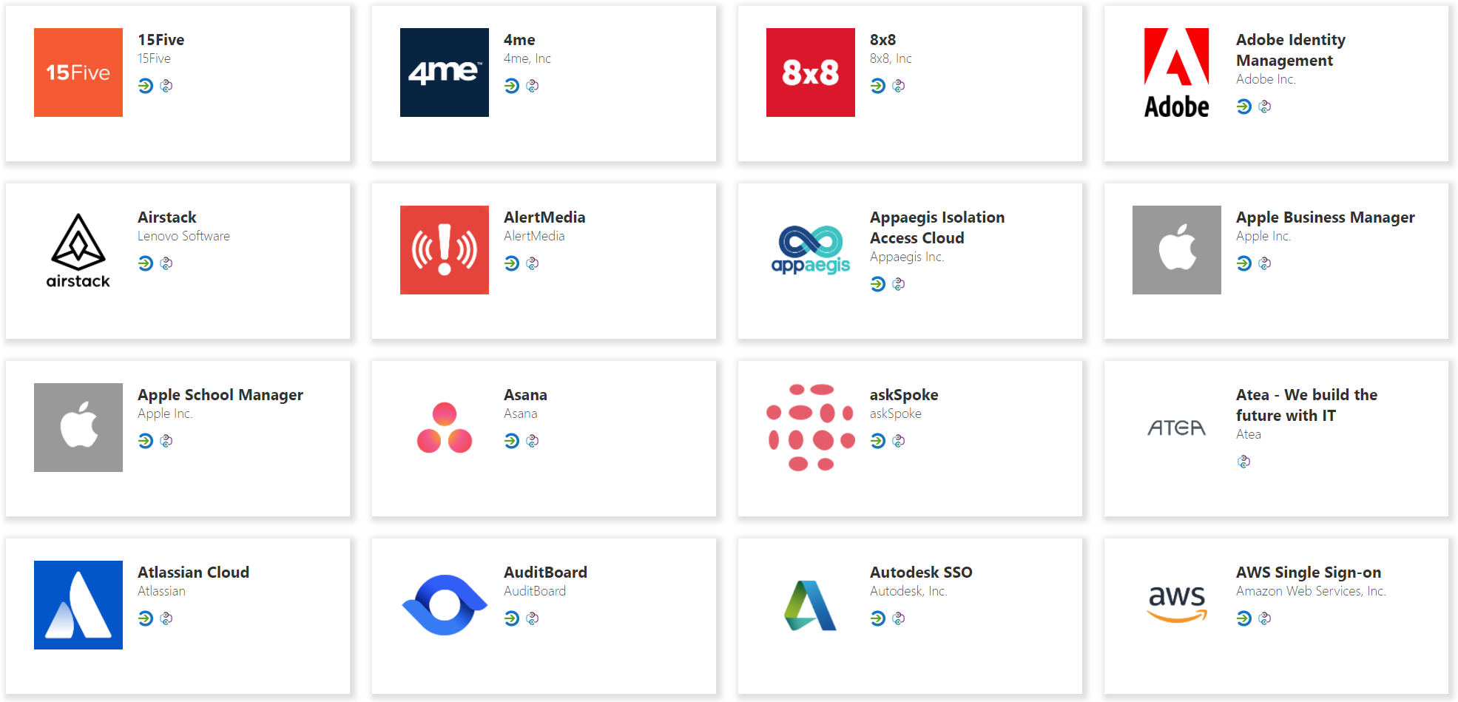
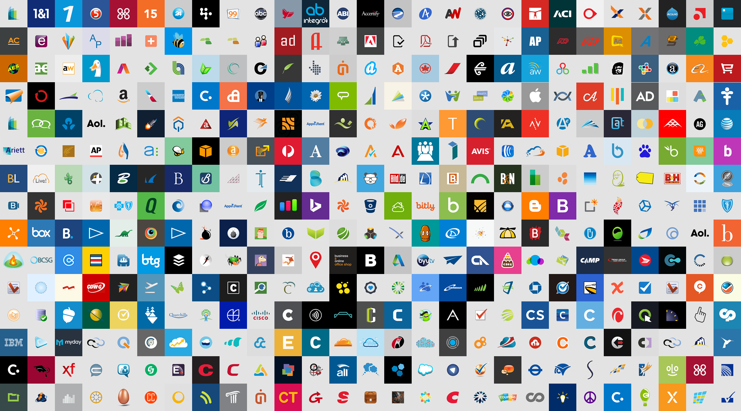
Provisioning to SaaS apps
Azure AD provisioning service connects to 3rd party apps via SCIM endpoints for user management
Automatically create, update or deactivate accounts in applications.
Ensure that the identities in your apps and systems are kept up to date based on changes in the directory or your human resources system.
Provision groups to applications that support them.
Take advantage of customizable attribute mappings that define what user data should flow from the source system to the target system.
Monitor and audit who has been provisioned into your applications.
The provisioning service provides alerts for critical events and allows for Log Analytics integration where you can define custom alerts to suit your business needs.
Azure AD
SaaS applications

Slide 36




Provisioning to on-premises applications
Users and schema defined in the cloud
Supports provisioning from custom schema extensions to app-specific properties.
Single sign-on and provisioning
SCIM
Translation to the provisioning protocols expected by apps
Microsoft-delivered connectors: LDAP, SQL, etc.
Ecosystem of third-party connectors for other apps requiring custom API integrations
Customers can re-use their existing MIM configuration
Azure AD provisioning agents
SOAP
LDAP
SQL
Notes:
SCIM compliant or SQL or LDAP data store.
Explicit direction to reuse MIM connectors
If you have a MIM connector to an app on prem you can reuse for this provisioning approach and it will work

Slide 37
Remote access and single sign-on to on-premises applications
Remote Access as a Service
Easily publish your on-premises applications to users outside the corporate network
On-premises applications
Azure Active Directory
Extend Azure AD to on-premises
Utilize Azure AD as a central management point for all your apps
Lightweight deployment- connectors only uses outbound connections, can support multiple apps.
Frictionless end user experience- connect from any browser and device with single sign-on.
Use apps as-is- any web app can be configured with App Proxy and benefit from single sign-on for IWA
Enforce pre-authentication- modern authentication and adaptive access.

Slide 38

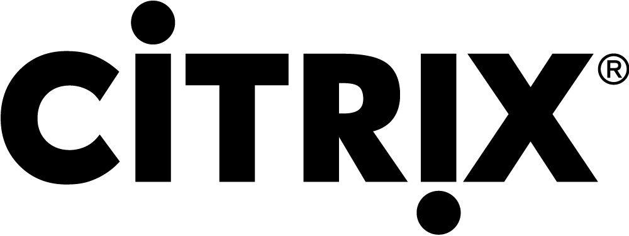
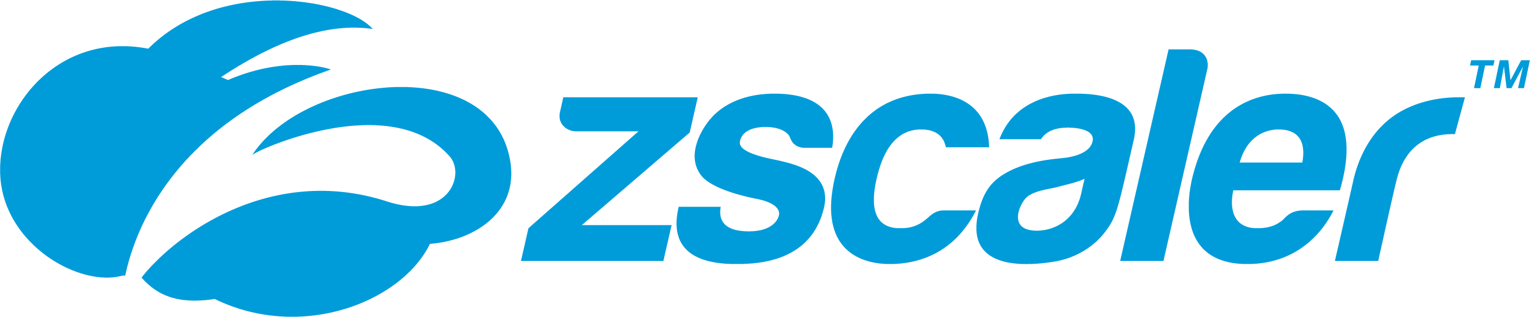

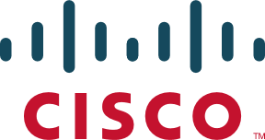


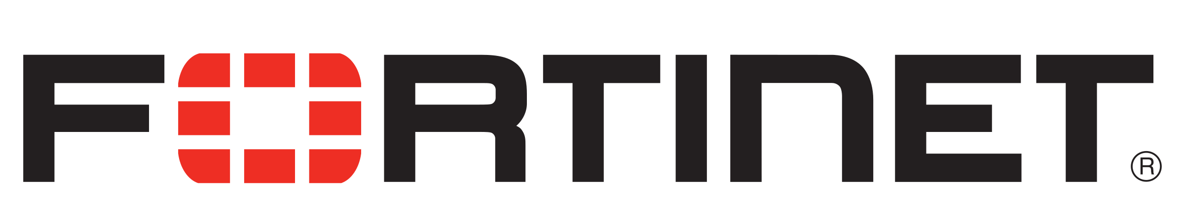
Secure Hybrid Access Partnerships
Secure hybrid access integrations to support broad range of legacy authentication protocols, including:
Kerberos
Header-based Auth
NTLM
LDAP
RDP
SSH
non-HTTP
Notes:
Expansion of secure hybrid access integrations to enable single sign-on for legacy applications that require legacy authentications, including Kerberos, Header based Auth, NTLM, LDAP, RDP, SSH, and Non-HTTP. New partners include Palo Alto Networks, Strata Identity, Cisco AnyConnect, Fortinet, and Kemp.

Slide 39
Contoso’s user journey
Just-in-time access, alerts, and approval workflows to protect access to critical resources
Automate the granting of access rights to resources
SaaS apps
Onboard the user into the directory when the user joins or start working with Contoso
On-premises apps
Access recertification to reduce risk
Self-Service access request when additional access is needed
Make sure access rights are removed when user leaves or stops working with Contoso
Teams sites
SharePoint Libraries
Ongoing auditing & reporting
Notes:
[Talk Track]
As Contoso’s users need additional access rights, Azure AD Identity Governance provides users with ability to do self-service access requests and for IT to request access rights reviews with approvals by managers, other users, or even the user themselves. Entitlement Management provides access lifecycle management for your employees as well as non-employees such as business partners or vendors.
Contoso can create pre-defined packages of resources that contain resources such as groups, apps, and SharePoint Online sites. You can then define policies on who can request access, for how long, include (multi-stage) approval workflows and separation of duties checks. Finally, users’ access can be time bound and regularly reviewed.

Slide 40



Access requests, workflow and approvals Entitlement management
Let users request access (to any connected app, group, Teams site and more) while automating access assignments, approval, workflows, reviews and expiration for all human identity types (users, guests, etc.)
Supports multi-stage approval workflow, separation of duties enforcement and recurring access recertification
Supports custom workflows for access lifecycle (through Logic Apps integration)
Self-service policy and workflow can be defined by app, group or site owners
Access time-limited, guests removed when last access expires
User
onboarded
Requests additional access
Access rights provisioned
Access reviewed & revised
Job
changes
Ongoing auditing & reporting

Slide 41
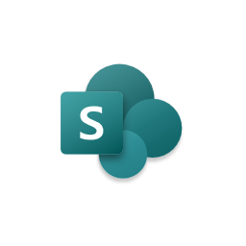
Facilitate cross-organization access
Contoso
Litware
Connected organization
Marketing catalog
Resources
Sales catalog
Litware user 1
Litware user 2
Litware user 3
Marketing
group
Sales team
group
Sales team group
Sales app
Sales site
Marketing app
Sales app
Sales person access package
Sales support access package
Sales team group: member
Marketing site
Sales site
Sales app: contributor
Sales site: member
Employees can request
Policies for access request, approval, review, lifecycle, separation of duties (SOD)
User 1
User 2
User 3
Outside sales reps can request

Slide 42

Custom workflows for access lifecycle
Contoso
Resources
Entitlement Management
Logic Apps
New video series, creating and using Entitlement Management Custom Extensions for Access Packages https://www.youtube.com/watch?v=tl1GZ_JGMBk
Sales support access package
Sales team
When access is requested:
Sales team group member
Notify sales team lead
Sales app User
When access is granted:
Sales app
Assign user to sales territories
Sales site Contributor
Policies
When access is removed:
Sales site
Custom workflow callouts
Reassign their sales leads
Employees can request
User 1
User 2
User 3
Outside sales reps can request
Access reviews
Guest account lifecycle Separation of duties checks

Slide 43



Guest attribute management
Administrator configures questions
Question: Have you read the NDA?
Attribute: What company are you from?
Collect additional information from requestors
Include custom questions that are surfaced within the request flow.
Approvers are shown the information as part of the request so they can make better decisions.
Requestor provides answers
Have you read the NDA? Yes
What company are you from? Fabrikam
Store provided information in User attributes
If your apps or processes need to reference it later, you can also store requestor information in attributes automatically.
Especially useful for onboarding external users.
Approver views answers and approves
Have you read the NDA? Yes
What company are you from? Fabrikam
Write attribute values to User object
User.Company = Fabrikam

Slide 44
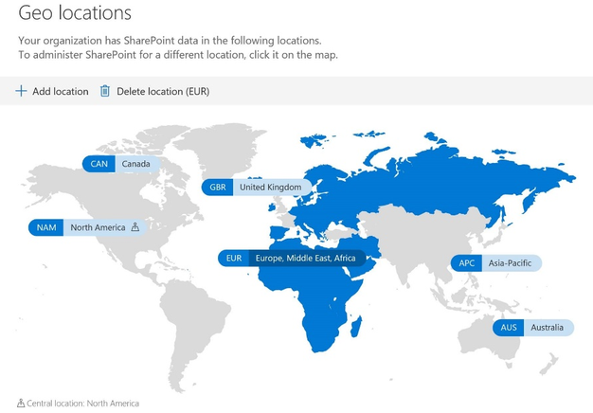
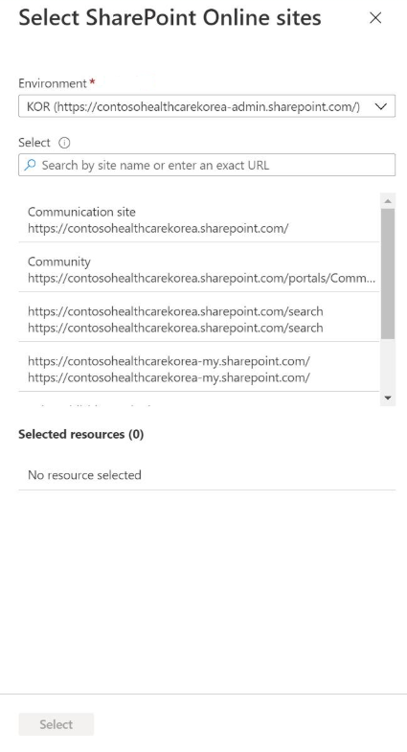
Multi-Geo SharePoint sites support
Multi-Geo capabilities in OneDrive and SharePoint Online enables control of shared resources like SharePoint team sites and Microsoft 365 Group mailboxes stored at rest in a specified geo location
Add a multi-geo SharePoint site to your catalog & access packages

Slide 45
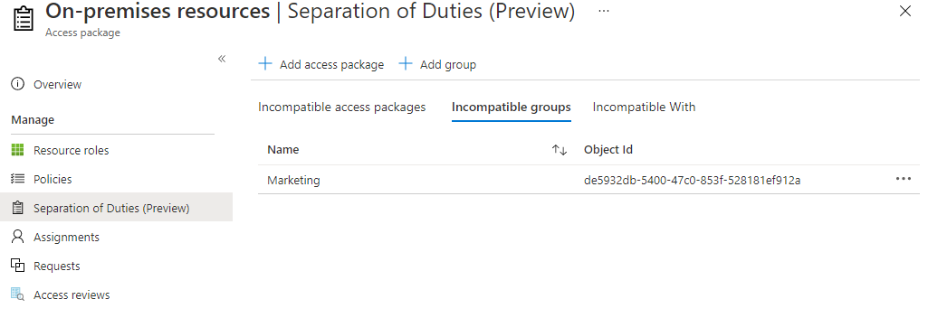
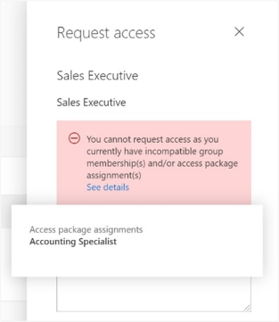
Separation of Duties
Configure that a user cannot request an access package
If they already have an assignment to another access package
If they are a member of a group
Notes:
In each of an access package's policies, you can specify who is able to request that access package, such as all member users in your organization, or only users who are already a member of a particular group. However, you may wish to further restrict access, in order to avoid a user from obtaining excessive access. With the separation of duties settings on an access package, you can configure that a user cannot request an access package, if they already have an assignment to another access package or are a member of a group.
For example, you have an access package, Marketing Campaign, that people across your organization and other organizations can request access to, to work with your organization's marketing department on that marketing campaign. Since employees in the marketing department should already have access to that marketing campaign material, you wouldn't want employees in the marketing department to request access to that access package. Or, you may already have a dynamic group, Marketing department employees, with all of the marketing employees in it. You could indicate that the access package is incompatible with the membership of that dynamic group. Then, if a marketing department employee is looking for an access package to request, they couldn't request access to the Marketing campaign access package.

Slide 46
Contoso’s user journey
Just-in-time access, alerts, and approval workflows to protect access to critical resources
Automate the granting of access rights to resources
SaaS apps
Onboard the user into the directory when the user joins or start working with Contoso
On-premises apps
Access recertification to reduce risk
Self-Service access request when additional access is needed
Make sure access rights are removed when user leaves or stops working with Contoso
Teams sites
SharePoint Libraries
Ongoing auditing & reporting
Notes:
[Talk Track]
An important requirement for Contoso is that users don’t have stale or unneeded access. They need to be recertified periodically to reduce the risk of stale or unneeded access.

Slide 47
Access recertification to reduce risk Access Reviews
Natively built-in to Azure AD
Manage risk and meet compliance for users, guests and workload identities
Ensure access to sensitive Teams, Groups, Apps, Roles is reviewed periodically
Notes:
[Talk Track]
The access recertification of Azure AD is called Access Reviews and is natively built-in to Azure AD. It helps Contoso to manage risk and meet compliance for your users, guests (or external users) and workload identities. It ensures that access to sensitive Teams, groups, apps and roles is periodically reviewed, and access is removed when necessary.

Slide 48
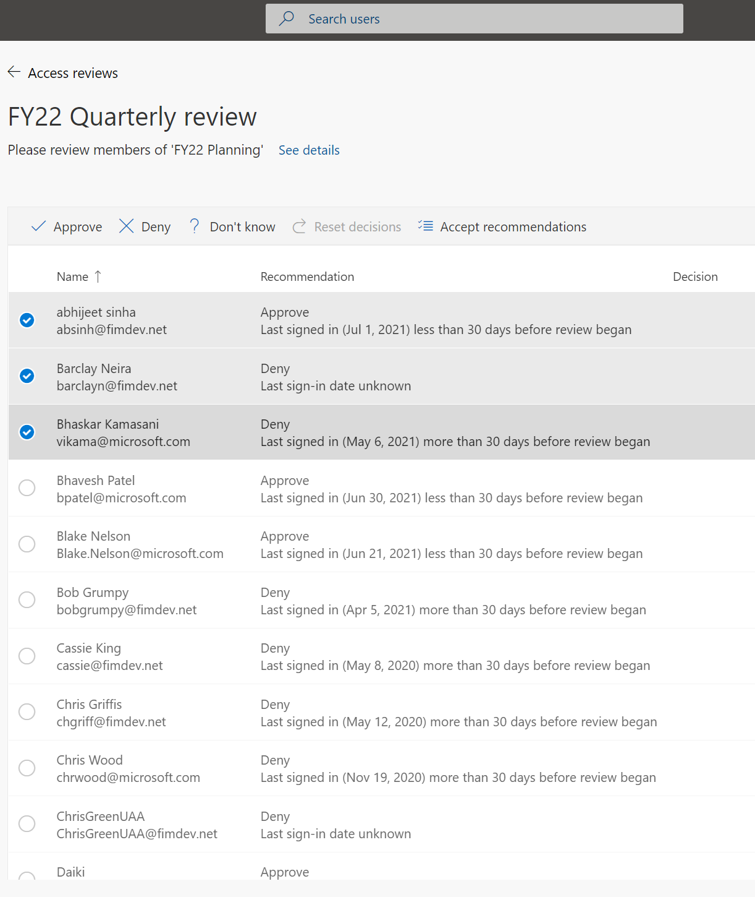

Access recertification to reduce risk Access Reviews
Policy-based access certification for automation
Native support for B2B guest users, privileged roles, non-human workload identities
Intelligent recommendations based on sign-in history
Customizable notifications to reviewers
Multi-stage reviews
Downloadable reports to see how reviewers are performing
Audit history for compliance reviews
Out-of-the-box integration with Microsoft Teams
Notes:
[Talk Track]
With Azure AD Access Reviews, Contoso can manage users assigned to groups, enterprise applications, access packages, and privileged roles to make sure they maintain a security standard. Regular oversight by the users themselves, resource owners, and other reviewers ensure that users don't retain access for extended periods of time when they no longer need it.
Azure AD Access Reviews is a policy-based access certification mechanism which can be used not just for Contoso's employees but also for their guest users and privileged roles. With the growing trend of more applications and services moving to the cloud it can also be used for non-human workload identities or Service Principals. To help reduce reviewer attestation fatigue it provides intelligent recommendations. The approval workflows can be customized and multi-staged (multiple approvers).
To gain more insight on Access Reviews or for audit and compliance needs there is the possibility to download an Access Review history report. These reports can be constructed to include specific access reviews, for a specific time frame, and can be filtered to include different review types and review result.

Slide 49
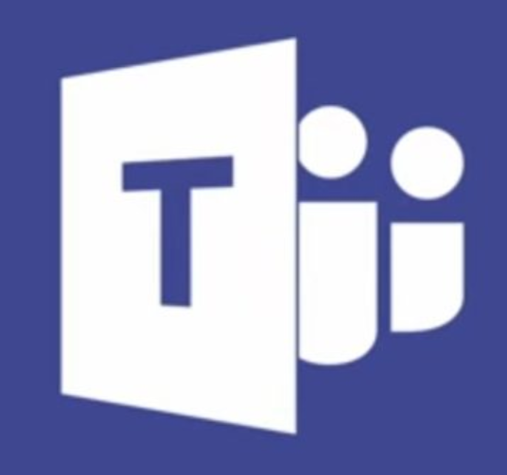
Reduce risk of guest users in Teams and Microsoft 365 groups
2. Guests are added to the team
Newly created groups that have guests, and existing groups that have newly added guests are automatically included in the review
Designate group owners or guests themselves to be the reviewer
Ensure that guest users retain only the access they need to Teams and Microsoft 365 groups
1. Creates a team
3. Access reviews detects teams with guests and triggers review on them
5. (Optional) Denied guests are blocked from signing in and then deleted
4. Membership reviewed; System provides recommendations based on last sign-in

Slide 50
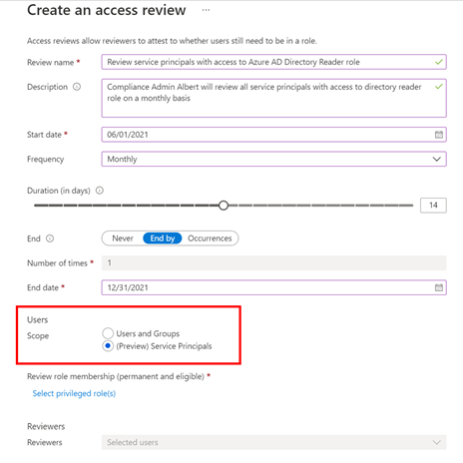
Access Reviews for service principals
Require a review of service principals and applications that are assigned to privileged directory roles
Create reviews of roles in your Azure subscriptions to which a service principal is assigned

Slide 51
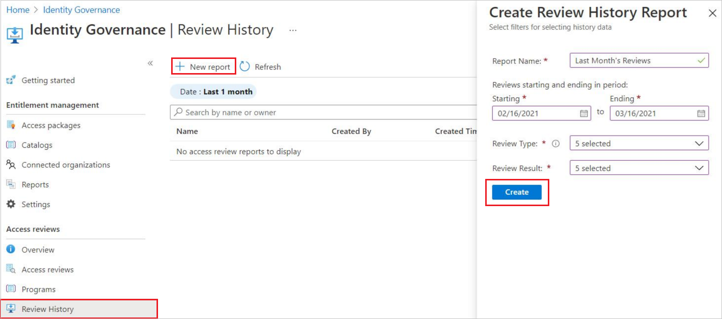
Access Review history report
Downloadable review history to gain more insight on Access Reviews
Download results for audit and compliance needs, or to integrate with other solutions
Reports can be constructed to include specific access reviews, for a specific time frame, and can be filtered to include different review types and review result

Slide 52
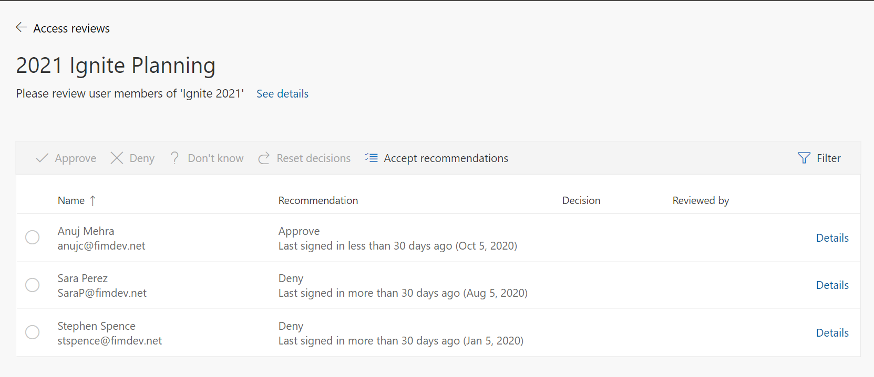
Enhanced Reviewer Recommendations
To help reduce reviewer attestation fatigue, Access Review includes information on the user’s last sign-in

Slide 53
Contoso’s user journey
Just-in-time access, alerts, and approval workflows to protect access to critical resources
Automate the granting of access rights to resources
SaaS apps
Onboard the user into the directory when the user joins or start working with Contoso
On-premises apps
Access recertification to reduce risk
Self-Service access request when additional access is needed
Make sure access rights are removed when user leaves or stops working with Contoso
Teams sites
SharePoint Libraries
Ongoing auditing & reporting
Notes:
[Talk Track]
What about Contoso’s admin accounts? They don’t want privileged accounts to have unnecessary access to critical apps and infrastructure as it can put their organization at risk.

Slide 54
Risks with Privileged Access
Admin
Number of permissions
Admin
Admin
Time
Admins gain levels of privileges over time
Notes:
[Talk Track]
Administrators are the folks who have lots of permissions, and if they get compromised can cause extensive damage to the environment. Over time, users may get assigned to admin roles and amass more and more admin privileges over time. The risk increases.

Slide 55
Least Privileged Access
Admin #3
Admin #3
Number of permissions
Admin #2
Admin #1
Admin #1
Password Admin 1 hr
Security Admin 2 hrs
Global Admin .5hr
Password Admin 1 hr
Global Admin .5 hr
Time
Secure and compliant by default, governed by the principle of Zero Standing Access, with Just-in-Time & Just-Enough-Access
Notes:
[Talk Track]
What you really want is… to not have standing admin access. Instead, admins should have just enough access and just in time for when it is needed. This helps reduce the users’ risk profile so even if a privileged user gets phished or attacked, the overall risk is vastly reduced.
For example, in the morning Admin #1 needs to reset a couple of passwords. He requests to be elevated to the password admin role and he will get that role for one hour. After one hour his account goes back to be a “normal” user account. Later that morning Admin #2 needs to create and update some security policies and he will be elevated for 2 hours. And Admin #3 needs to onboard a new service and configure a tenant wide setting and will be elevated into the Global Admin role for 30 mins. This will be a pattern that you would like to see during the day; admins only have just enough access and only when they need it. The rest of the time they are normal users.

Slide 56
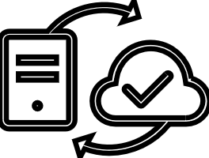

Implementing least privilege access Privileged Identity Management (PIM)
Least Privileged Access
Built-in governance controls
On-demand just-in-time administrative access
Periodic access certification for privileged accounts
Just enough access with support for roles (built-in and custom) and privileged access groups
Privileged account discovery and analytics
Approval workflows for privileged activation
Audit history of activations and built-in alerts
User
Administrator
Administrator privileges expire after a specified interval
User
Notes:
[Talk Track]
With the help of Azure AD Privileged Identity Management (PIM) Contoso can minimize account privileges. Some key features of Privileged Identity Management are:
Identify and manage users assigned to administrative roles
Understand unused or excessive privilege roles you should remove
Provide just-in-time privileged access to Azure AD and Azure resources
Assign time-bound access to resources using start and end dates
Require approval to activate privileged roles
Enforce multi-factor authentication to activate any role
Use justification to understand why users activate
Get notifications when privileged roles are activated
Conduct access reviews to ensure users still need roles
Download audit history for internal or external audit
Prevents removal of the last active Global Administrator role assignment
Instead of having administrative privileges permanently assigned, accounts will be eligible for administrative privileges. Appropriate policies can be established to make sure when they need to gain access to those privileged roles, they can do so securely, with the necessary change control. In the policy things like duration of the privileges, needed approvals, etc. can be specified.
Note: As part of deploying your privileged account process, follow the best practice to create at least two emergency accounts to make sure you still have access to Azure AD if you lock yourself out.

Slide 57
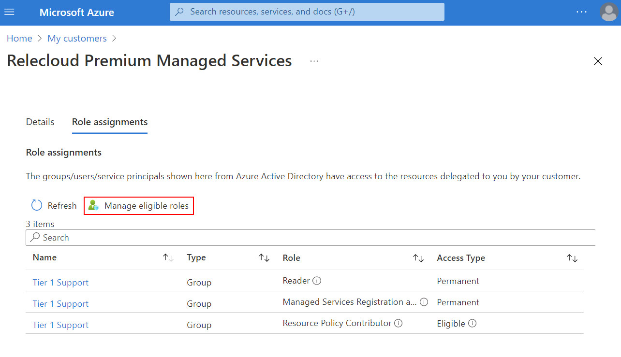
Just-in-time Cross tenant Azure Resource access Privileged Identity Management (PIM) + Azure Lighthouse
Azure Lighthouse is Microsoft's multitenant management solution for use by its managed service provider (MSP) partners that allows to setup cross tenant resource access.
Azure AD PIM integration allows you to setup eligible access to Azure RBAC roles on resources in another tenant through the Azure Lighthouse offering.
The integration supports multifactor authentication challenge as well as tracking the activation/deactivation via the audit log.
Notes:
https://azure.microsoft.com/en-us/blog/privileged-identity-management-with-azure-lighthouse-enables-zero-trust/

Slide 58
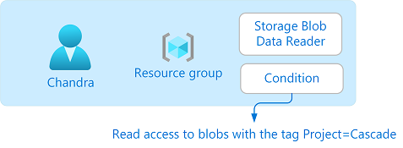
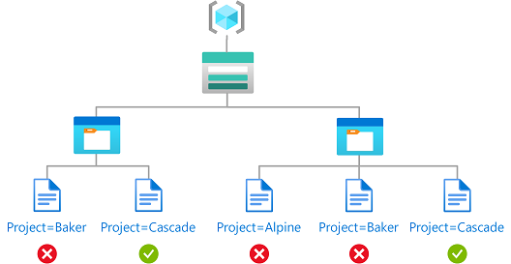
Just-in time fined-grained access management Privileged Identity Management (PIM) + Azure Attribute-Based Access Control (ABAC)
Attribute-based access control (ABAC) is adding role assignment conditions based on attributes in the context of specific actions.
Benefits of using role assignment conditions:
Provide more fine-grained access control
Help reduce the number of role assignments
Use attributes that have a specific business meaning
Add conditions to eligible role assignments using Privileged Identity Management (PIM):
Enables you to limit a user's access to a resource using fine-grained conditions
Secure it with a time-bound setting, approval workflow, audit trail, and so on.
Notes:
[Talk Track]
Attribute-based access control (ABAC) is an authorization system that defines access based on attributes associated with security principals, resources, and environment. With ABAC, you can grant a security principal access to a resource based on attributes. Azure ABAC refers to the implementation of ABAC for Azure.
Azure ABAC builds on Azure RBAC by adding role assignment conditions based on attributes in the context of specific actions. A role assignment condition is an additional check that you can optionally add to your role assignment to provide more fine-grained access control. A condition filters down permissions granted as a part of the role definition and role assignment. For example, you can add a condition that requires an object to have a specific tag to read the object. You cannot explicitly deny access to specific resources using conditions.
There are three primary benefits for using role assignment conditions:
Provide more fine-grained access control - A role assignment uses a role definition with actions and data actions to grant a security principal permissions. You can write conditions to filter down those permissions for more fine-grained access control. You can also add conditions to specific actions. For example, you can grant John read access to blobs in your subscription only if the blobs are tagged as Project=Blue.
Help reduce the number of role assignments - Each Azure subscription currently has a role assignment limit. There are scenarios that would require thousands of role assignments. All of those role assignments would have to be managed. In these scenarios, you could potentially add conditions to use significantly fewer role assignments.
Use attributes that have specific business meaning - Conditions allow you to use attributes that have specific business meaning to you in access control. Some examples of attributes are project name, software development stage, and classification levels. The values of these resource attributes are dynamic and change as users move across teams and projects.
You can also add conditions to eligible role assignments using Privileged Identity Management (PIM). With PIM, your end users must activate an eligible role assignment to get permission to perform certain actions. Using conditions in PIM enables you not only to limit a user's access to a resource using fine-grained conditions, but also to use PIM to secure it with a time-bound setting, approval workflow, audit trail, and so on.

Slide 59
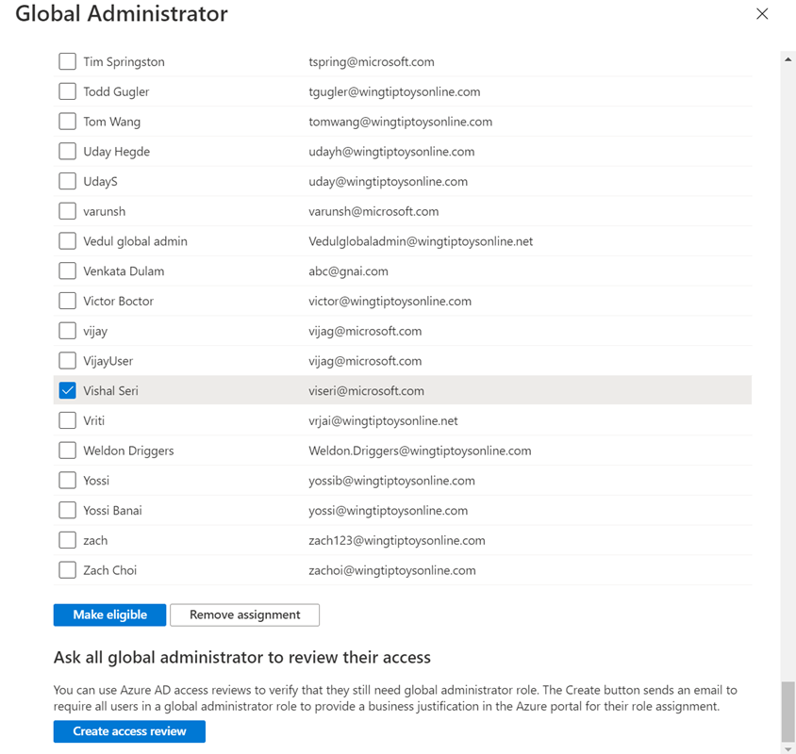
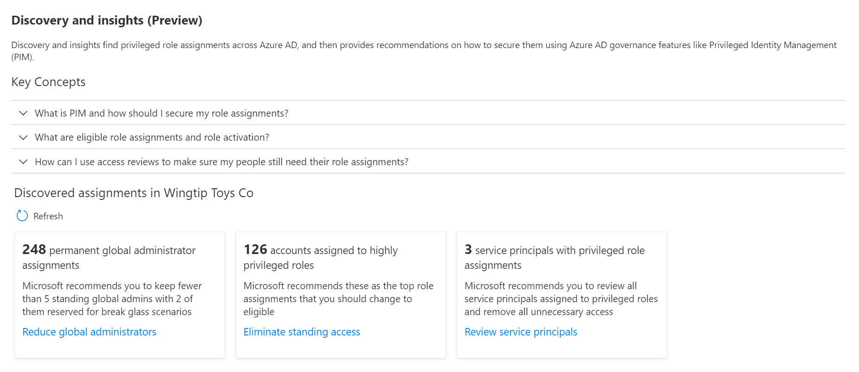
Discover which users and service principals have permanent assignments to highly privileged roles
View a list of permanent privileged role assignments.
Review service principals with privileged role assignments.
Make changes to your permanent privileged role assignments:
Make the assignment eligible,
Remove the assignment,
Create an access review on the role.
Notes:
8 highly privileged roles, like privileged role administrator, user account admin, security admin

Slide 60
Contoso’s user journey
Just-in-time access, alerts, and approval workflows to protect access to critical resources
Automate the granting of access rights to resources
SaaS apps
Onboard the user into the directory when the user joins or start working with Contoso
On-premises apps
Access recertification to reduce risk
Self-Service access request when additional access is needed
Make sure access rights are removed when user leaves or stops working with Contoso
Teams sites
SharePoint Libraries
Ongoing auditing & reporting
Notes:
[Talk Track]
And last, when a user is leaving Contoso the user needs to be de-provisioned from the applications and the directory so that he/she no longer has access to Contoso’s resources.

Slide 61
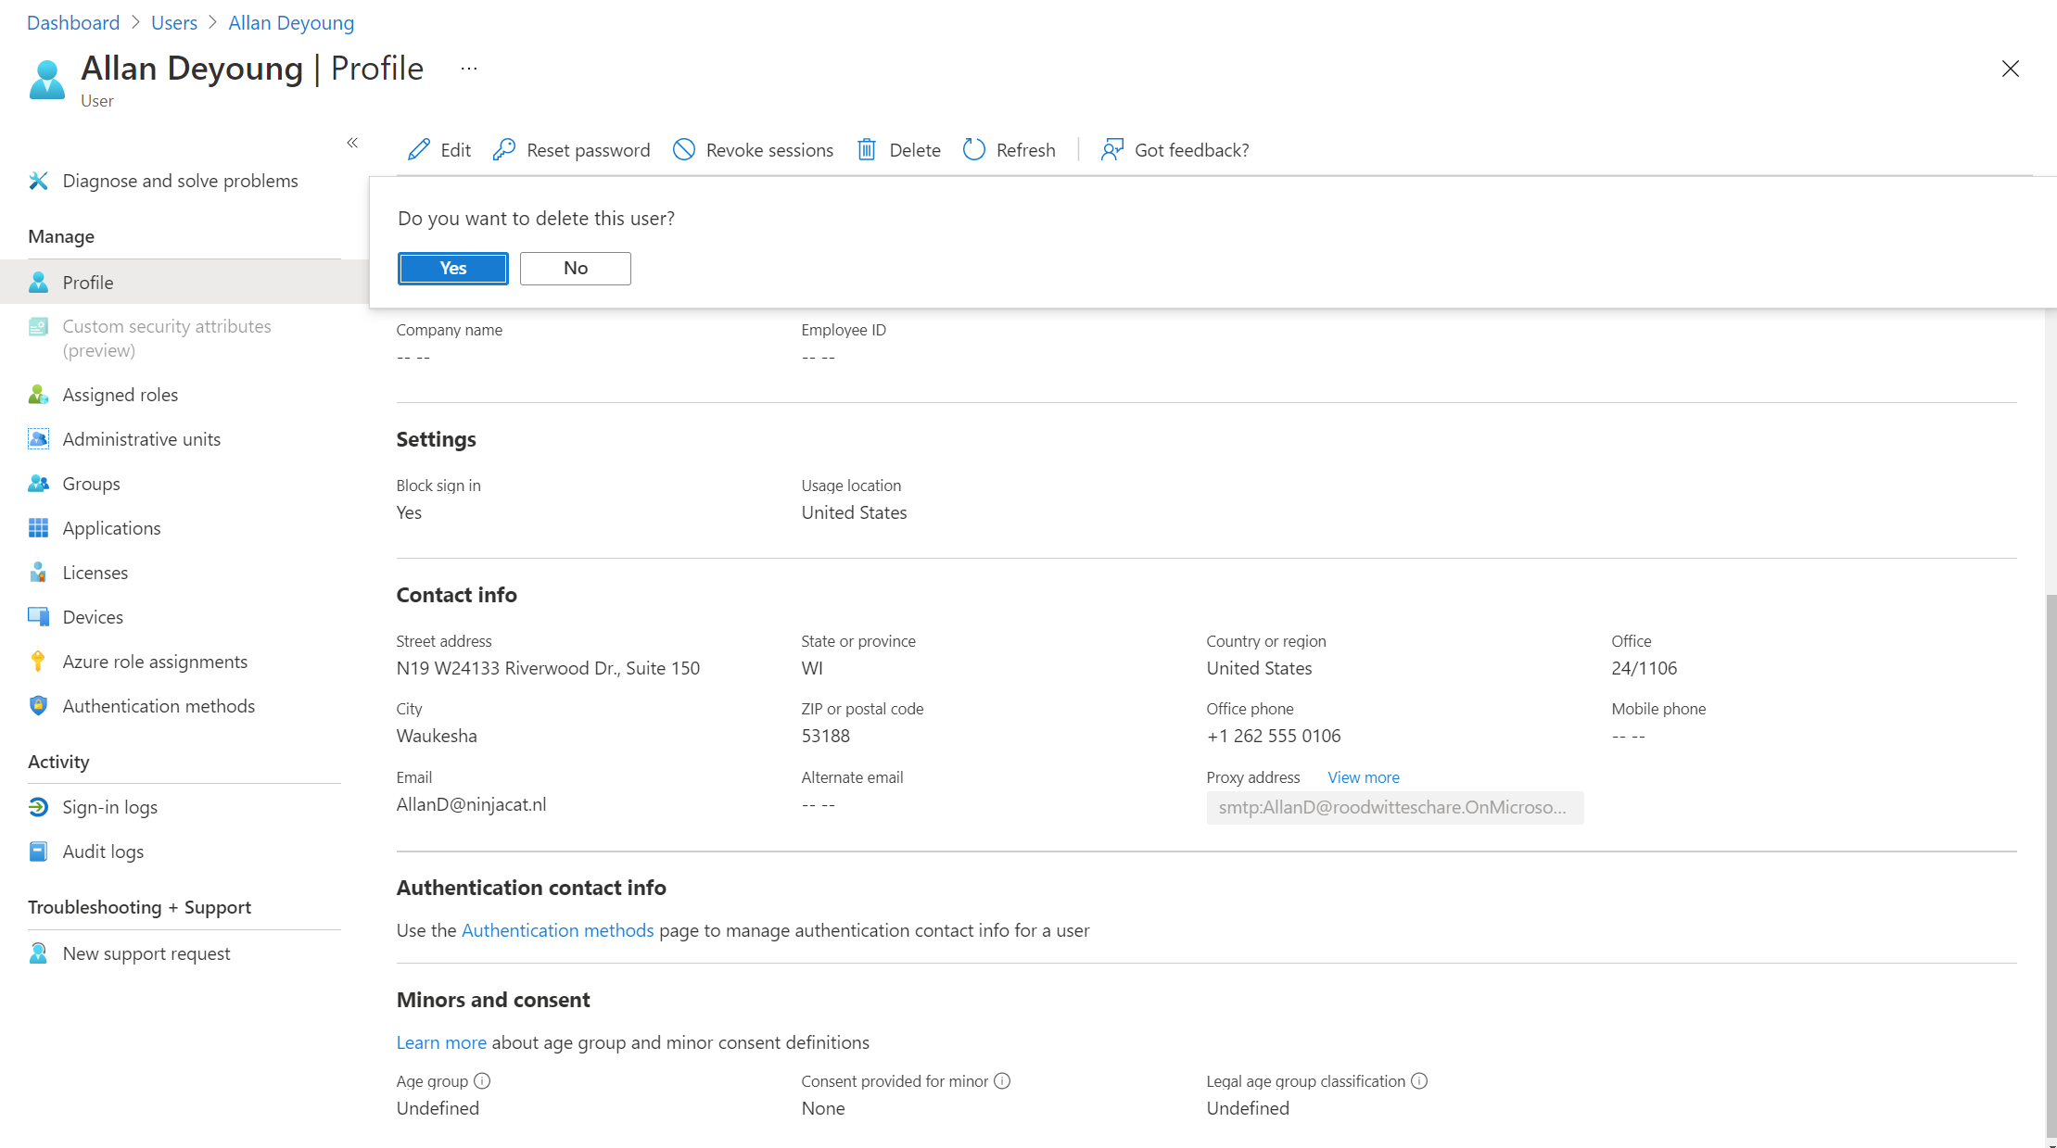
Removing access
Reduce risk by cleaning up accounts that are no longer needed
Delete a user from the directory or block sign-in
Azure AD provisioning service keeps source and target systems in sync and deprovisionins accounts when users should not have access anymore
Increase efficiency and save money (license costs)

Slide 62
Removing access
Directory
Delete a user or block sign-in
Account will be in a suspended state for 30 days after deletion
User account be restored with all of its properties during that 30-day window
Permanently deleted after that 30-day window
Applications
Azure AD provisioning service keeps source and target systems in sync
De-provisioning accounts when users should not have access anymore:
The user account is deleted in Azure AD
The user is unassigned from the application
The user no longer meets a scoping filter and goes out of scope
The AccountEnabled property is set to False
Soft delete a user by default if the application supports soft deletes

Slide 63
Contoso’s user journey
Just-in-time access, alerts, and approval workflows to protect access to critical resources
Automate the granting of access rights to resources
SaaS apps
Onboard the user into the directory when the user joins or start working with Contoso
On-premises apps
Access recertification to reduce risk
Self-Service access request when additional access is needed
Make sure access rights are removed when user leaves or stops working with Contoso
Teams sites
SharePoint Libraries
Ongoing auditing & reporting
Notes:
[Talk Track]
During this whole lifecycle, Contoso needs the ability to log all events, including provisioning, access requests, account elevation and access certification events. The audit data can be used for reporting, viewed in dashboards or send to an external system.

Slide 64
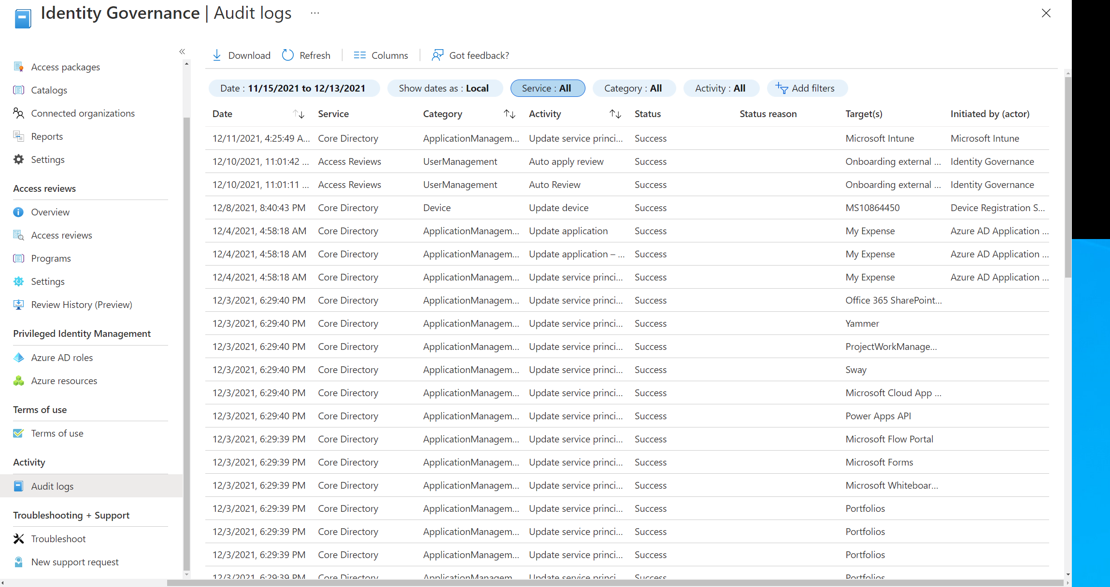
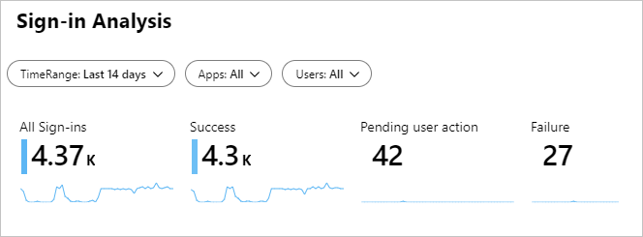
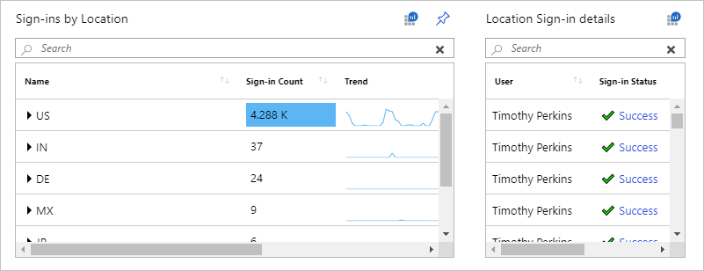
Know how your environment is doing Reporting & Monitoring
Determine how your apps and services are utilized by your users.
Detect potential risks affecting the health of your environment.
Troubleshoot issues preventing your users from getting their work done.
Assess whether and how you need to respond to potential issues.
Integrate with Azure Monitor & Microsoft Sentinel:
Retain data for a long(er) time.
Rich visualizations, monitoring and alerting.
Possibility to integrate with (other) SIEM tools.
Notes:
[Talk track]
You want to know how your IT environment is doing. The information about your system’s health enables you to assess whether and how you need to respond to potential issues.
To support you with this goal, the Azure Active Directory portal gives you access to three activity logs:
Sign-ins – Information about sign-ins and how your resources are used by your users.
Audit – Information about changes applied to your tenant such as users and group management or updates applied to your tenant’s resources.
Provisioning – Activities performed by the provisioning service, such as the creation of a group in ServiceNow or a user imported from Workday.
Azure AD retains the logs for 30-days for Azure AD Premium customer. You can retain the audit and sign-in activity data for longer than the default retention period by routing it to an Azure storage account using Azure Monitor. This will not only enable you to retain data for a longer time but will also provide you rich visualizations using workbooks. There are a number of workbooks out of the box, but you can create your own custom workbook as well. Azure Monitor integration can also be used to stream data to SIEM tools like Microsoft Sentinel, ArcSight or Splunk.
Another way of controlling how long logs are stored is by downloading them. You can download up to 250 000 records through the console. If you want to download larger data sets then you can use the reporting API. The downloads can be scoped by filter. CSV and JSON are the supported formats for downloading logs.

Slide 65
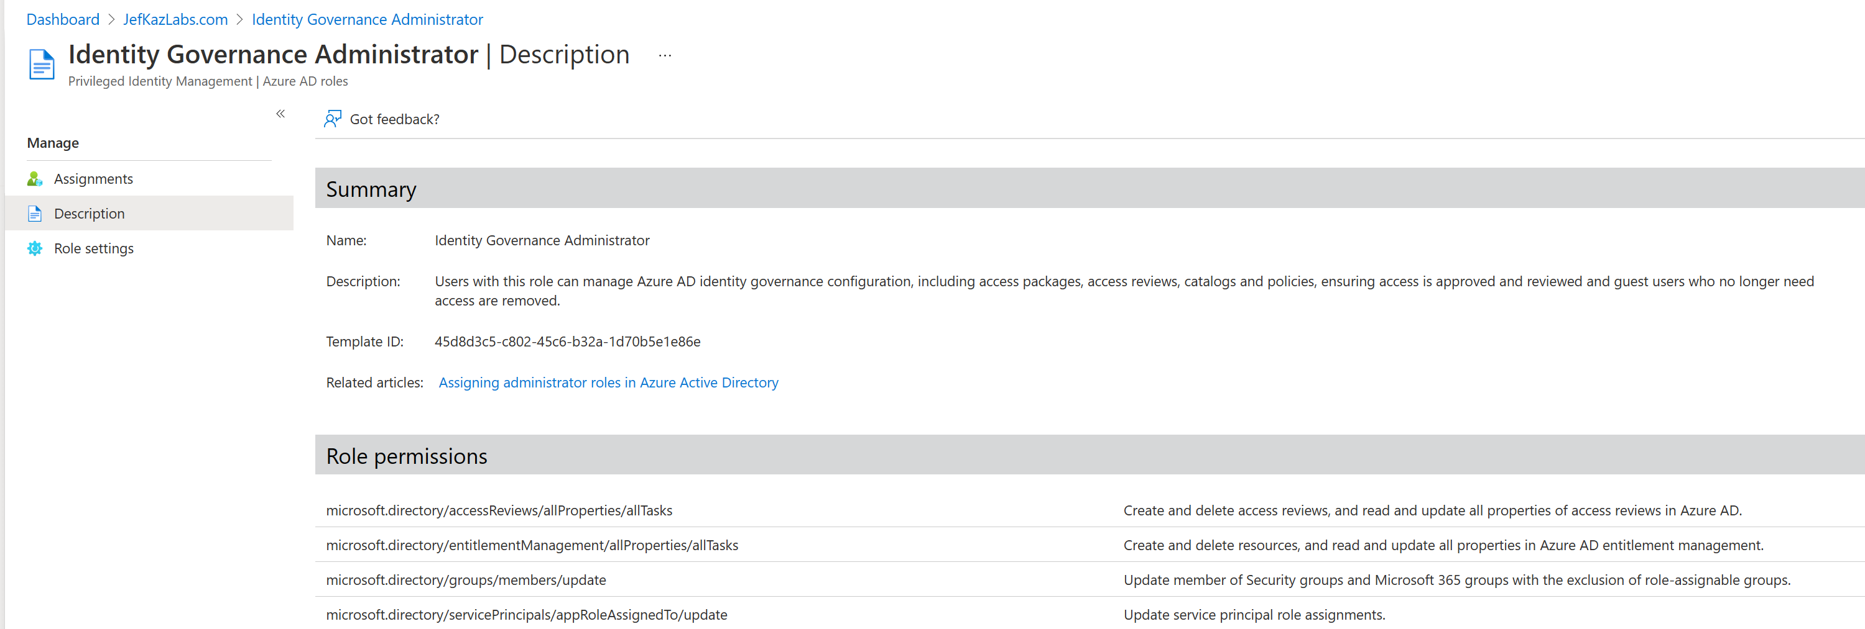
Identity Governance Administrator Role
Users with this role can manage Azure AD Identity Governance configuration, including:
Access packages
Access reviews
Catalogs
Policies
Permits finer-grained control and avoids users accumulating excessive or unanticipated access rights
Recommended role for managing Azure AD Identity Governance

Slide 66


Simplified identity governance with Azure AD
Automatic provisioning and de-provisioning for identity lifecycle (connected to HR platform)
Entitlement management for granting and reviewing access​ and workflows to request access for both employees and guest users
Open and interoperable ecosystem, integration through REST APIs and client libraries as well as Logic Apps
Policy-based access certification with intelligent recommendations to reduce risk
Privileged identity management with time-limited access
Notes:
Access is easy to grant but much harder to keep track of. You need to track who was given access to what resources, and revoke access in a timely manner when it is no longer needed. Controls should apply to both internal and external users.
Azure AD Identity Governance, a native part of Azure AD, allows Contoso to protect, monitor, and audit access to critical assets. It will help to ensure that only authorized users have access based on policies, provide employees and guests users with workflows to request access, establish regular access recertification to validate if access is still needed and establish effective controls with time-limited access privileged roles assignments.

Slide 67
Azure AD Identity Governance
Capability | Scenarios
Identity lifecycle (employees) | IT can enable user account provisioning from Workday or SuccessFactors cloud HR, or on-premises HR.
Identity lifecycle (guests) | IT can enable self-service guest user provisioning from another Azure AD tenant, direct federation, One Time Passcode (OTP) or Google accounts. Guest users are automatically provisioned/ deprovisioned subject to lifecycle policies.
Entitlement management | Resource owners can create access packages containing Apps, Azure AD groups, Teams, Office groups, SharePoint Online sites and site collections.
Access requests | End users can request group membership or application access. End users, including guests from other organizations, can request access to access packages.
Workflow | Resource owners can define the approvers and escalation approvers for access requests up to 3 levels.
Policy and role management | Admin can define conditional access policies for run-time access to applications. Resource owners can define policies users’ access via access packages.
Access certification | IT can enable recurring access re-certification for: SaaS apps or cloud group memberships, Teams, Azure AD or Azure Resource role assignments. Automatically remove resource access, block guest access and delete guest accounts.
Fulfillment and provisioning | Automatic provisioning and deprovisioning into Azure AD connected apps, including via SCIM, SharePoint Online sites, groups, Teams.
Reporting and analytics | IT can retrieve audit logs of recent user provisioning and sign on activity. Integration with Azure Monitor and Log Analytics for ‘who has access’ via access packages.
Privileged access | Just-in-time and scheduled access, alerting, approval workflows for Azure AD roles (including custom roles), Azure Resource roles and Privileged Access groups.
Auditing | IT can be alerted of creation of admin accounts and unused role assignments.
http://aka.ms/IdentityGovernanceOverview

Slide 68
Resources
Azure AD identity blog aka.ms/IdentityBlog
Azure AD product page azure.com/AzureAD
Microsoft Identity solution page microsoft.com/Identity
Azure AD technical documentation aka.ms/AzureAD
Azure AD product videos youtube.com/MsftSecurity
Try Azure AD free azure.com/trial

